Slide 1
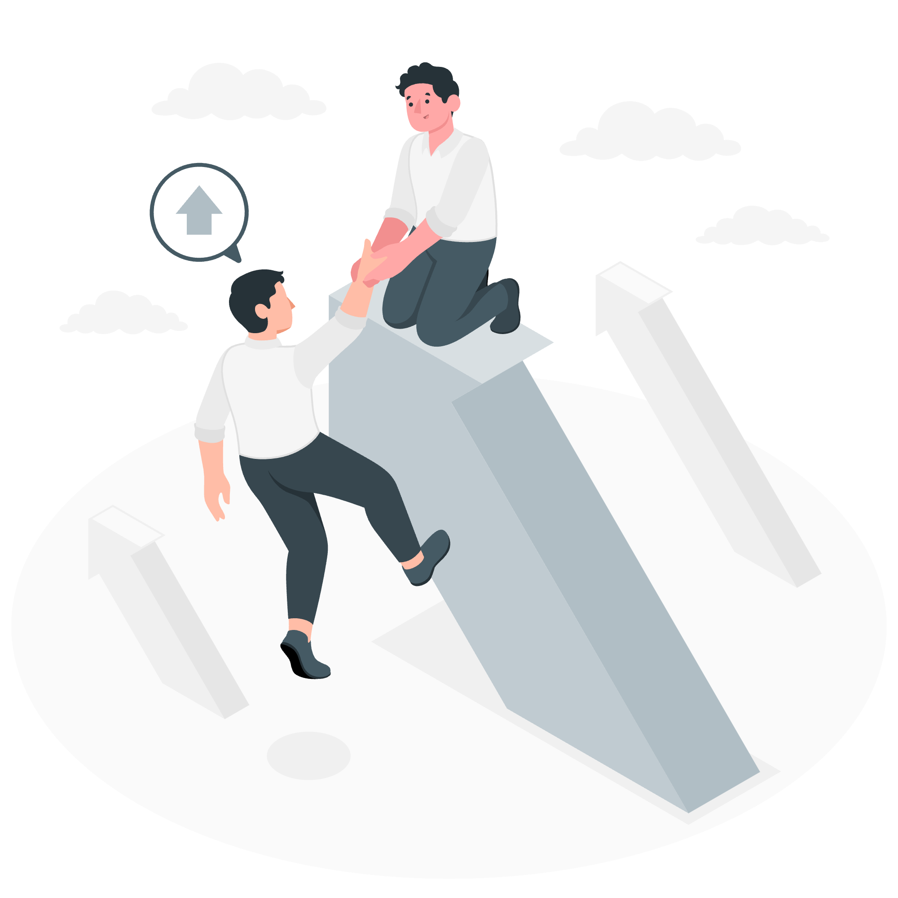

The Research Data Alliance a global community driven initiative
Friday 23 August 24
Hilary Hanahoe
Secretary General, RDA
hilary.hanahoe@rda-foundation.org
www.rd-alliance.org
CODATA-RDA Data Schools

Slide 2
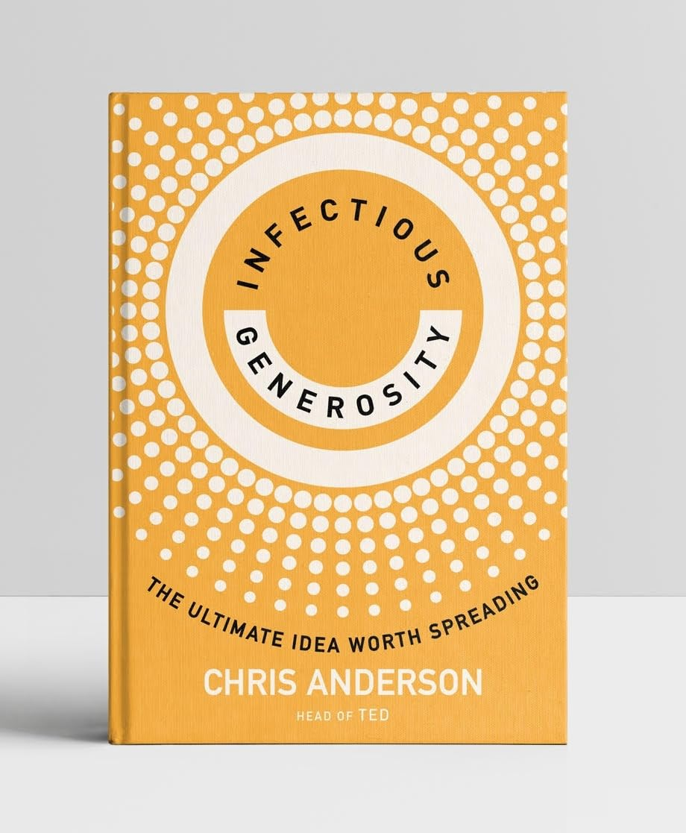
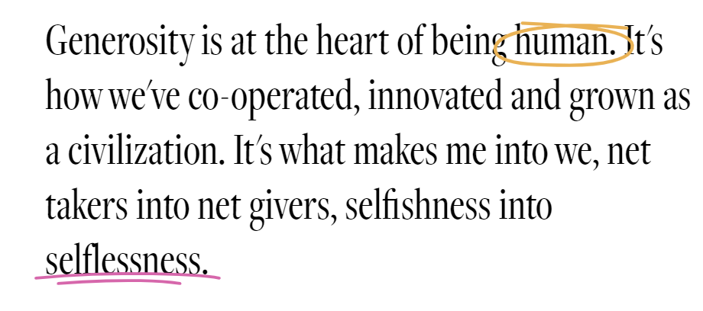
Source: infectiousgenerosity.org
Open Access Australasia (OAA) | SCOSS Webinar
Notes:
You will all be familiar with the TED talks and TED concept, and probably also know of Chris Anderson, the CEO / Head of TED who recently published a book entitled «Infectious Generosity» In his own words., Generosity is at the heart of being human. It's how we've co-operated, innovated and grown as a civilization. It's what makes me into we, net takers into net givers, selfishness into selflessness. ‍Infectious Generosity is the idea that through the power of the internet, small acts of thoughtfulness spread to change lives at a scale never experienced before.
Well I have the great priviledge and honour to represent a global community of volunteer, passionate, driven data experts who practice infectious generosity every day of their lives.

Slide 3

About the RDA 🌍
Guiding principles
Openness
Consensus
Inclusivity
Harmonisation
Community-driven
Non-profit & technology neutral
Vision
Researchers and innovators openly share and re-use data across technologies, disciplines, and countries to address the grand challenges of society.
Mission
RDA builds the social and technical bridges that enable open sharing and re-use of data.
Friday 23 August 24
CODATA-RDA Data Schools
Notes:
RDA produces the adaptors to ensure you can access the electricity you need anywhere in the world.

Slide 4

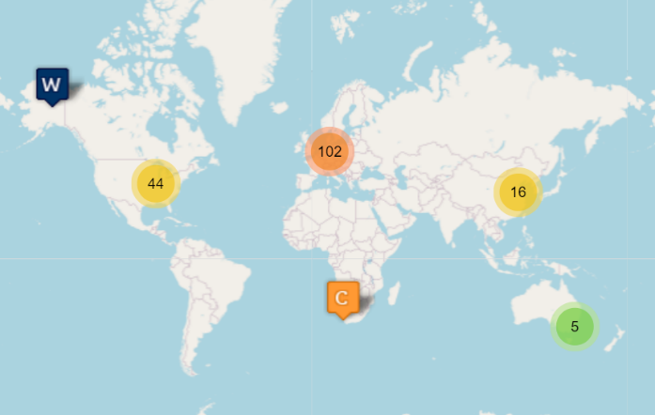
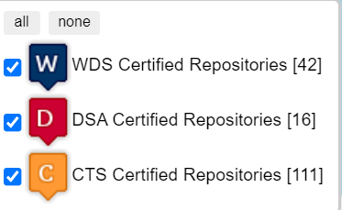
universal catalogue of requirements reflects the core characteristics of trustworthy data repositories
www.coretrustseal.org

Slide 5
WHO: The RDA Family - Open to all
Friday 23 August 24
Individuals
(14,500+)
Organisations
(85+)
Nations / Regions
(35+)
“a strategic think tank to enhance a constructive dialogue and collaboration on themes relevant to data science and to present the latest research results in many areas”
“one of the few places where researchers and data managers / information professionals directly interact and collaborate to develop solutions and best practices”
“a global perspective to assist in sharing best practices, experiences and common needs to achieve efficiency and reduce duplication of efforts”
CODATA-RDA Data Schools

Slide 6

Grass-roots, bottom-up, organic creation to address global challenges
How: The heart of the RDA - Community groups
Friday 23 August 24
Working Groups
Interest Groups
Communities of Practice
Develop & implement tools, policy, practices & products for data that are adopted & used by projects, organisations, & communities
Life span: 12-18 months
Focus on solving a specific data sharing problem and identifying what kind of infrastructure needs to be built
Life span: As long as group is active
Domain/disciplinary focus, coordination and awareness raising role - ‘umbrella group’
Life span: as long as CoP is active (review every 18 months)
1 CoP on Agricultural Data
RECOMMENDATIONS: Concrete deliverables - “Running code”, tools, standards, etc.
OUTPUT: Best practices, guidelines, emergence of new working groups (WGs), etc.
OUTPUT:
New WGs & IGs, bridge building across the RDA and externally.
CODATA-RDA Data Schools

Slide 7
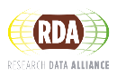
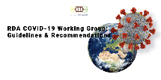
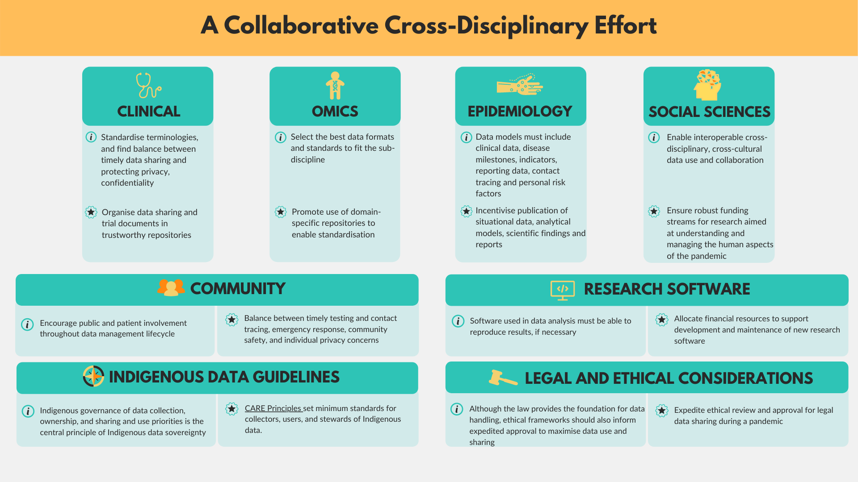
RDA COVID-19 WG Recommendations and Guidelines on Data Sharing: https://doi.org/10.15497/rda00052

Slide 8
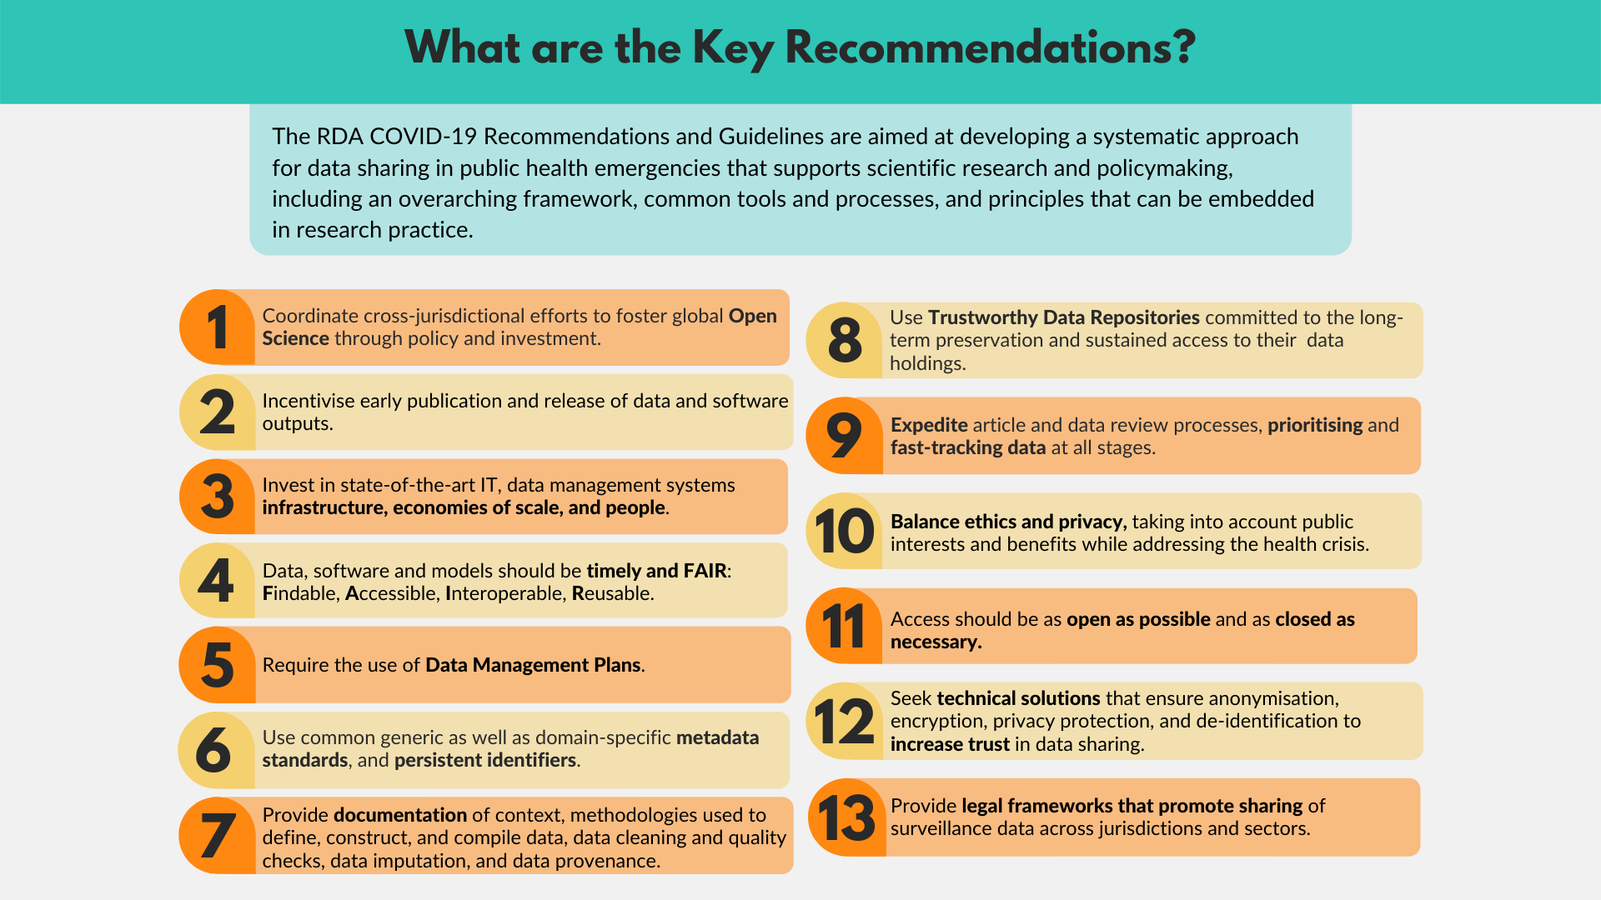

Slide 9
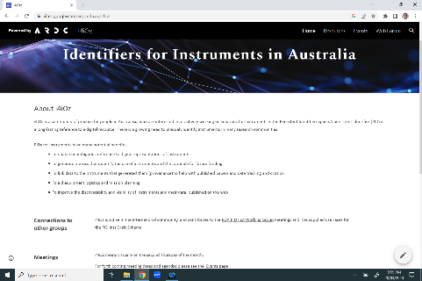
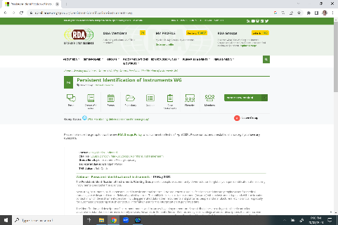


RDA: a structure to address global data challenges
Australian Community of Practice model
Source: RDA: delivering 10 years of value to Australian Data Infrastructure, RDA Plenary 20, Gothenburg, Sweden, March 2023, Natasha Simons, Australian Research Data Commons (ARDC)

Slide 10
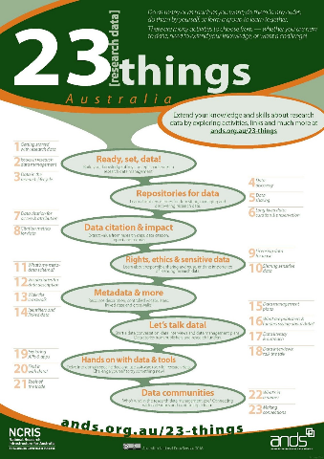
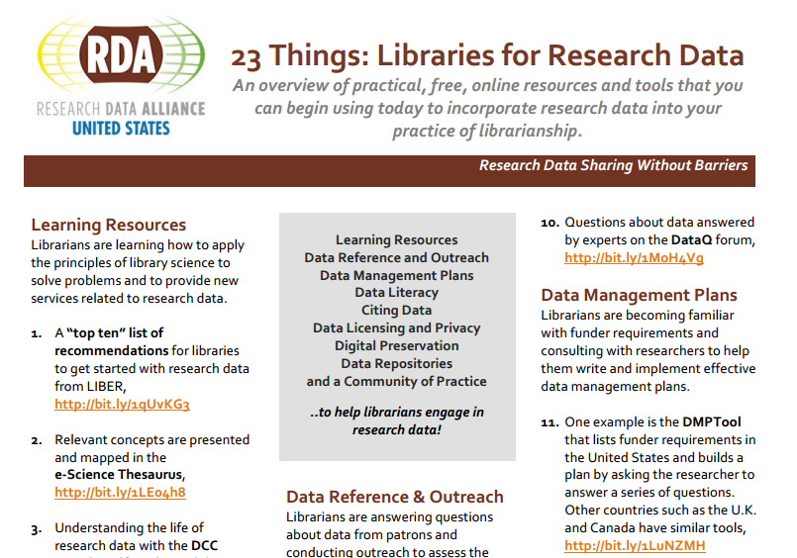
RDA: outputs that can be adopted and adapted
Source: RDA: delivering 10 years of value to Australian Data Infrastructure, RDA Plenary 20, Gothenburg, Sweden, March 2023, Natasha Simons, Australian Research Data Commons (ARDC)

Slide 11

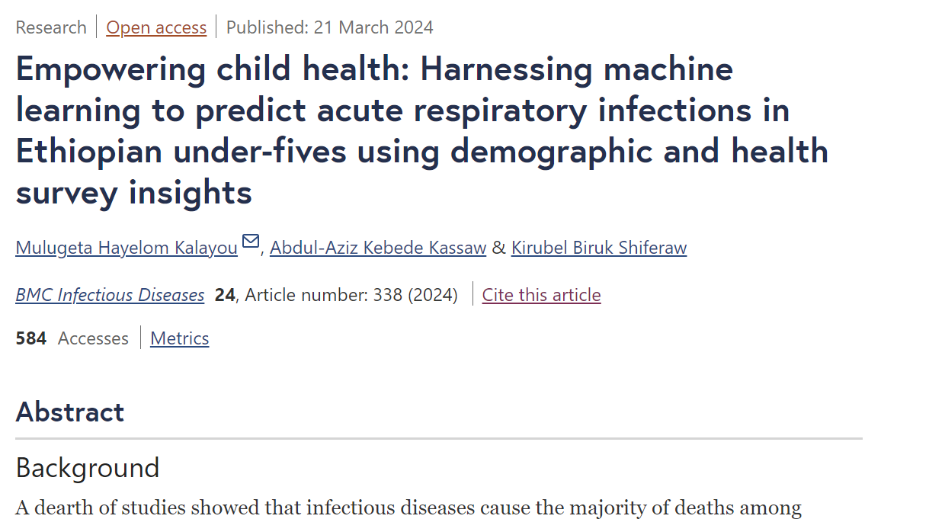
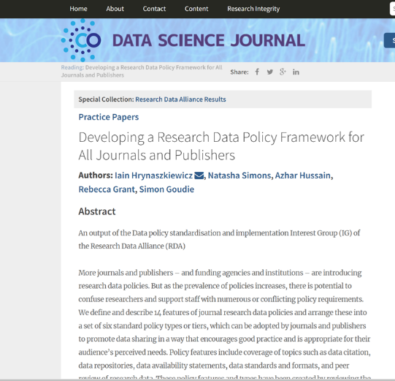
RDA: outputs that have real-world impact

Slide 12
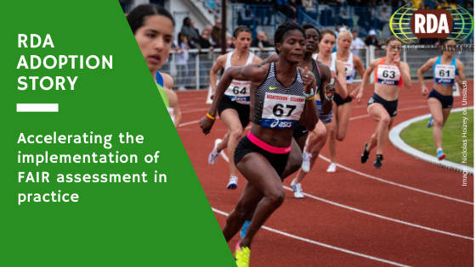
FAIR Data Maturity Model: specification and guidelines
IMPACT: a maturity model for FAIR assessment with assessment indicators, priorities and evaluation methods. Used for the normalisation of assessment approaches to enable comparison of their results.
FAIR Data Maturity Model WG: Recommendation package DOI: 10.15497/rda00050

Slide 13
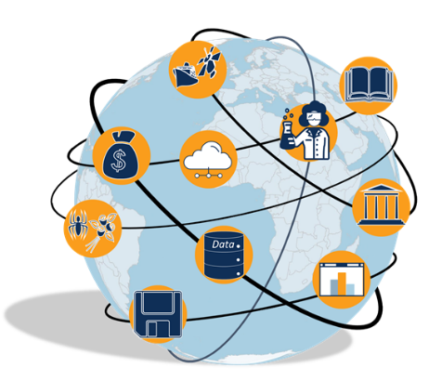
GLOBAL OPEN RESEARCH COMMONS (GORC)
GORC International Model WG
a set of pertinent attributes to identify common features across RESEARCH / SCIENCE commons and when possible identifying how they measure their user engagement with these features
https://archive.rd-alliance.org/groups/gorc-international-model-wg

Slide 14
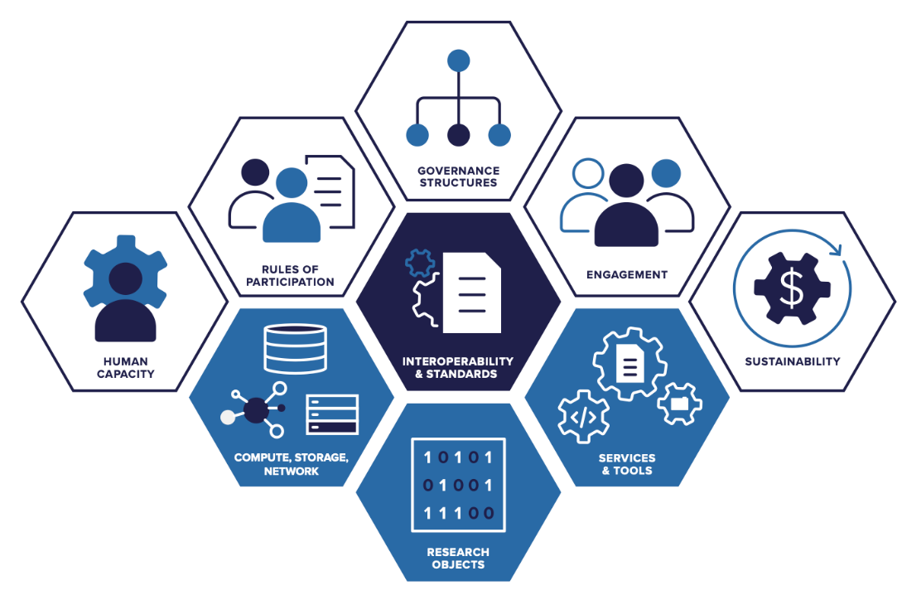
GORC-IG Essential Elements of a Commons

Slide 15
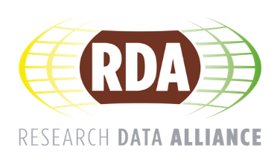
The community MEETINGS RDA PLENARY MEETINGS 2024 & 2025

Slide 16
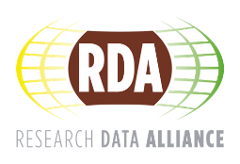
What are rda plenary meetings & why should they interest you?
Working Meetings for the RDA Community to advance their activities
Opportunity for new members to join groups: contribute, learn, observe
Understand the different RDA community in areas of interest to you
Join the global community of «data lovers»

Slide 17

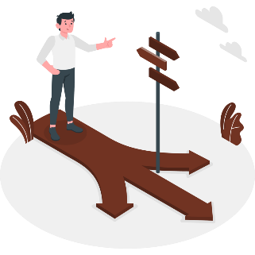
NAVIGATING RDA & PLENARY MEETINGS: RDA PATHWAYS
FAIR, CARE, TRUST Principles: Adoption, Implementation, and Deployment
Data Infrastructures and Environments: Institutional | Regional or Disciplinary | International
Training, Stewardship, and Data Management Planning
Data Lifecycles - Versioning, Provenance, Citation, and Reward
Semantics, Ontology, Standardisation
Discipline Focused Data Issues
Research Software
RDA PATHWAYS - https://www.rd-alliance.org/rda-pathways/
Research Data Alliance Pathways: RDA 21st Plenary Synopsis
Version: July 2023. Cite as: Connie Clare, & Fares Dhane. (2023). Research Data Alliance Pathways: RDA 21st Plenary Synopsis. https://doi.org/10.15497/RDA00094

Slide 18
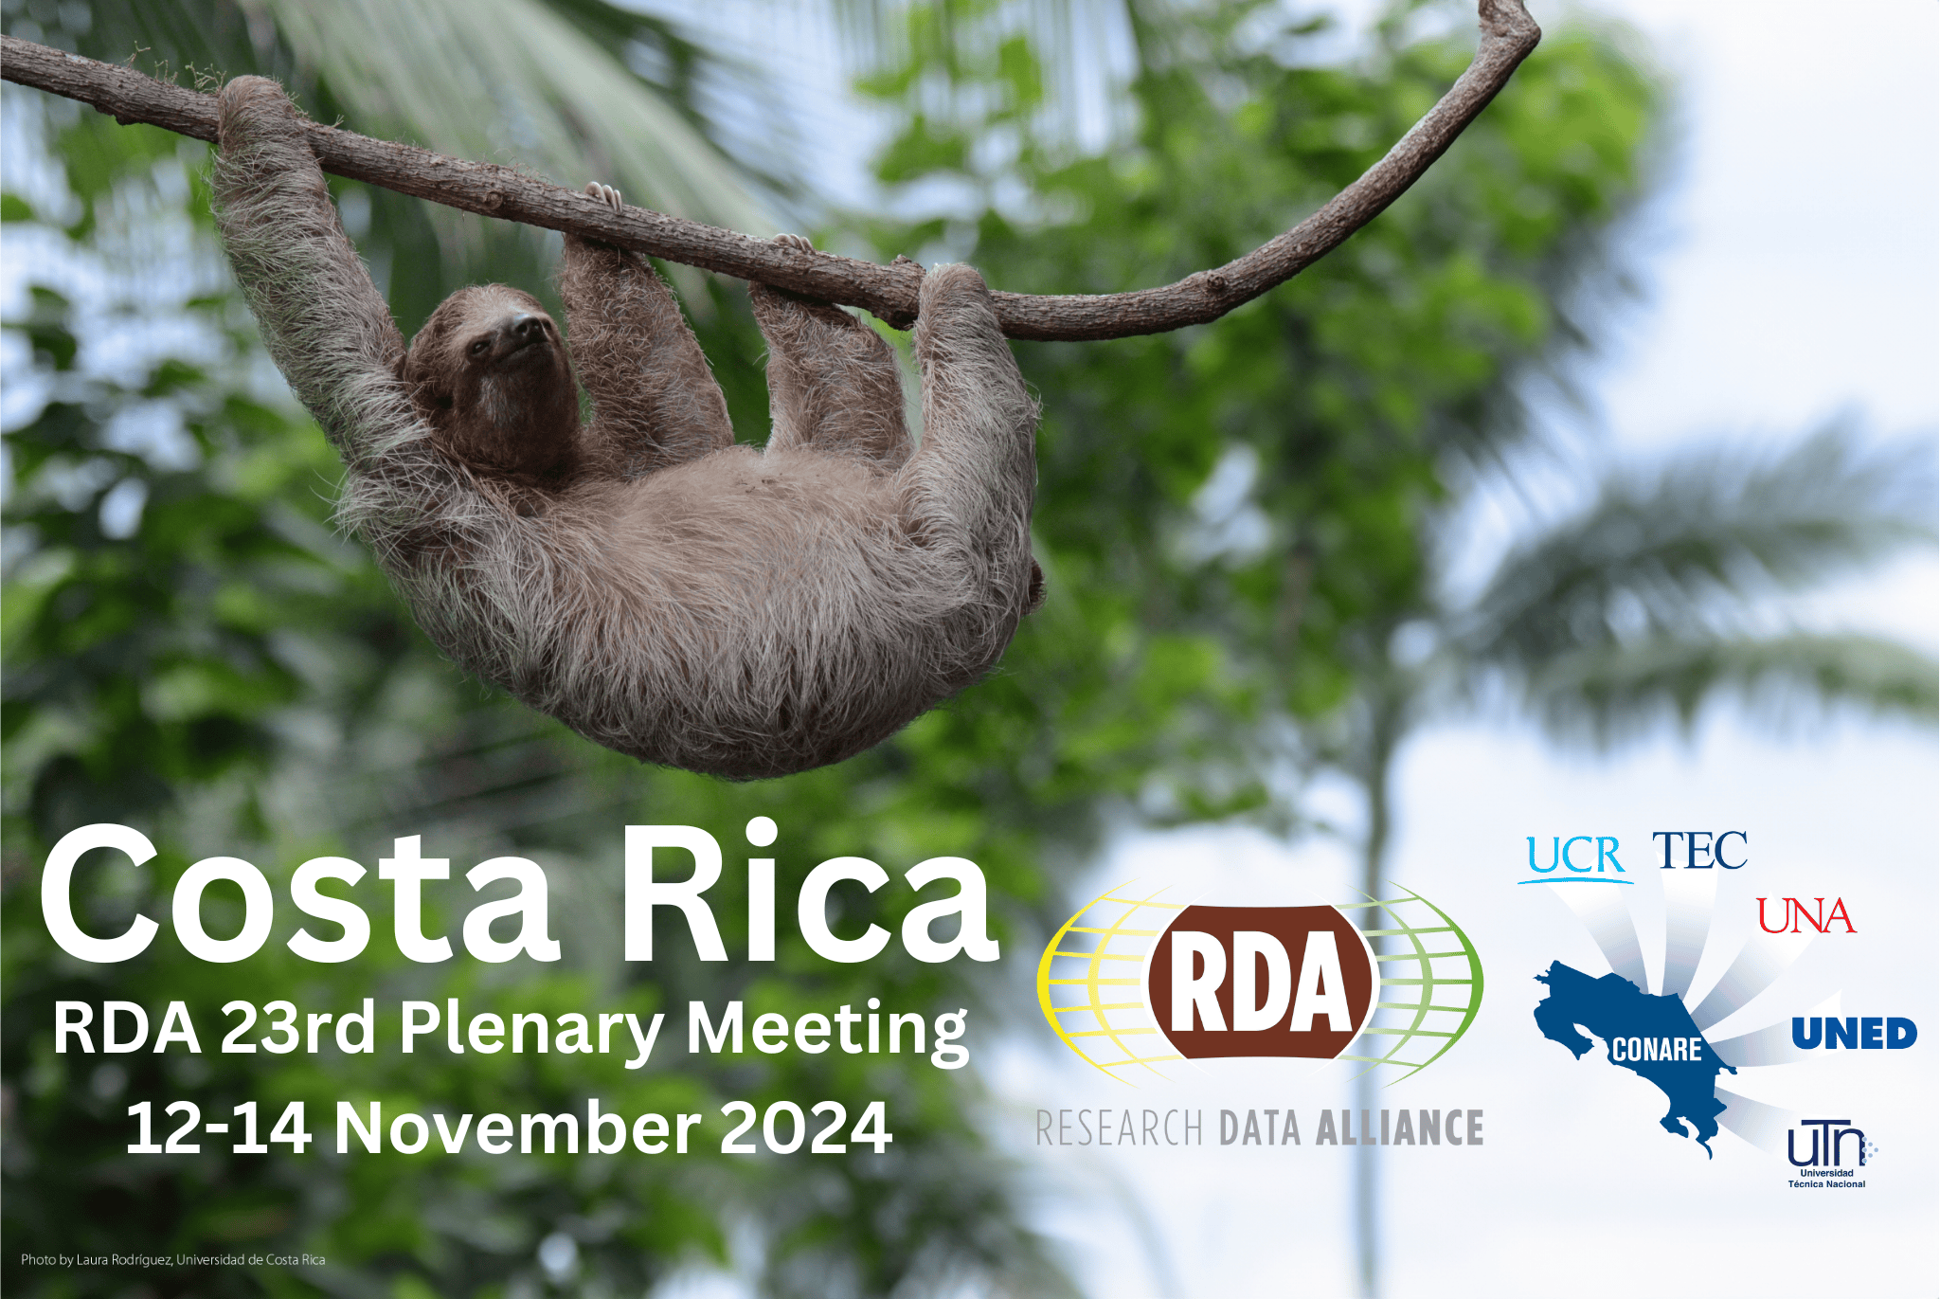
https://www.rd-alliance.org/event/rda-23rd-plenary-meeting-san-jose-costa-rica/

Slide 19
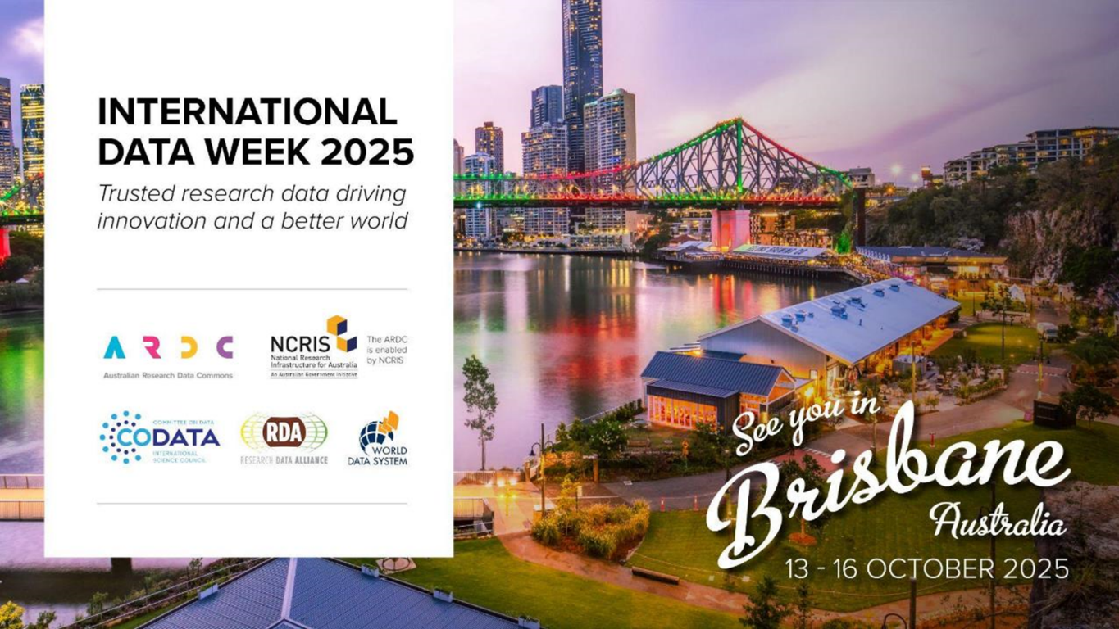
Including
Research Data Alliance 25th Plenary Meeting
https://www.rd-alliance.org/plenaries/international-data-week-2025-brisbane-australia

Slide 20

The Research Data Alliance: How to get involved

Slide 21
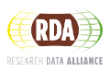
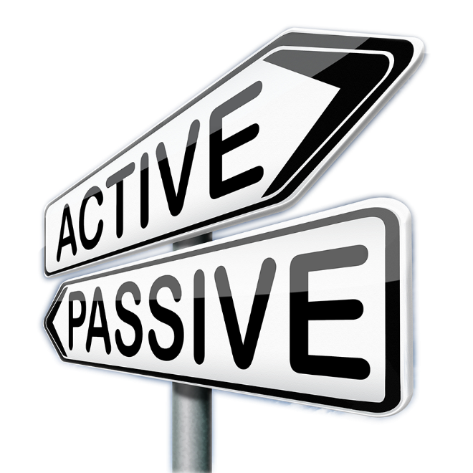
Join RDA as an Individual Member
Feel free to engage at the level of your choice:
Driver
Contributer
Observer
ALL ARE WELCOME

Slide 22
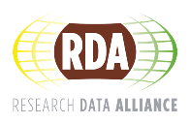
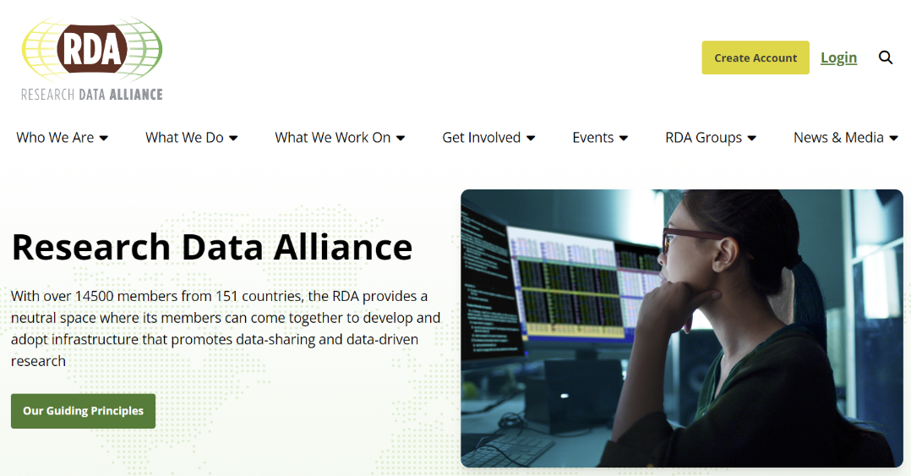
Join RDA as an Individual Member
https://www.rd-alliance.org/

Slide 23
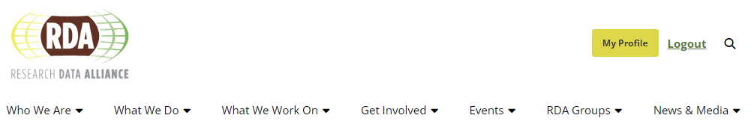
Your rda community member profile
Manage your profile, preferences, subscriptions, etc.

Slide 24
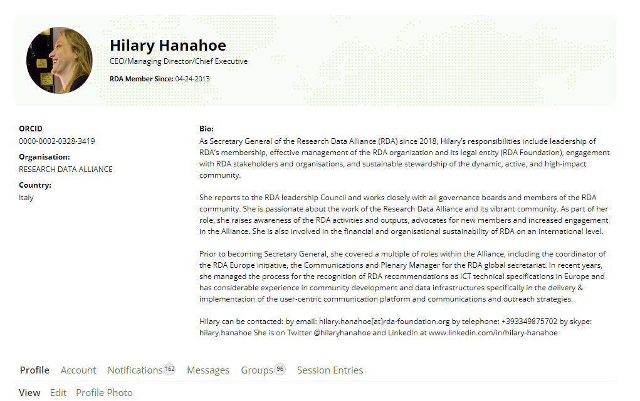
Your rda community member profile
Manage your profile, preferences, subscriptions,

Slide 25
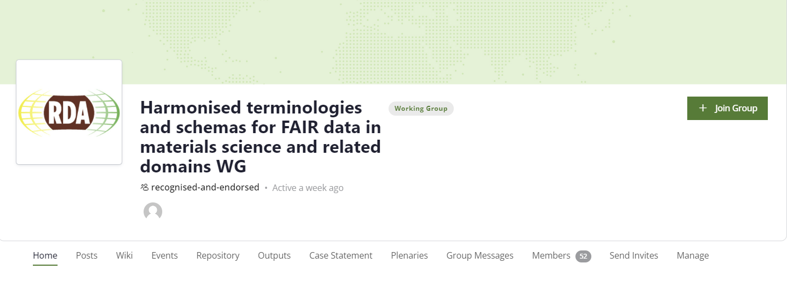
HOW TO Join RDA GROUPS
Select JOIN GROUP to subscribe and receive updates, post to group and follow the activities

Slide 26
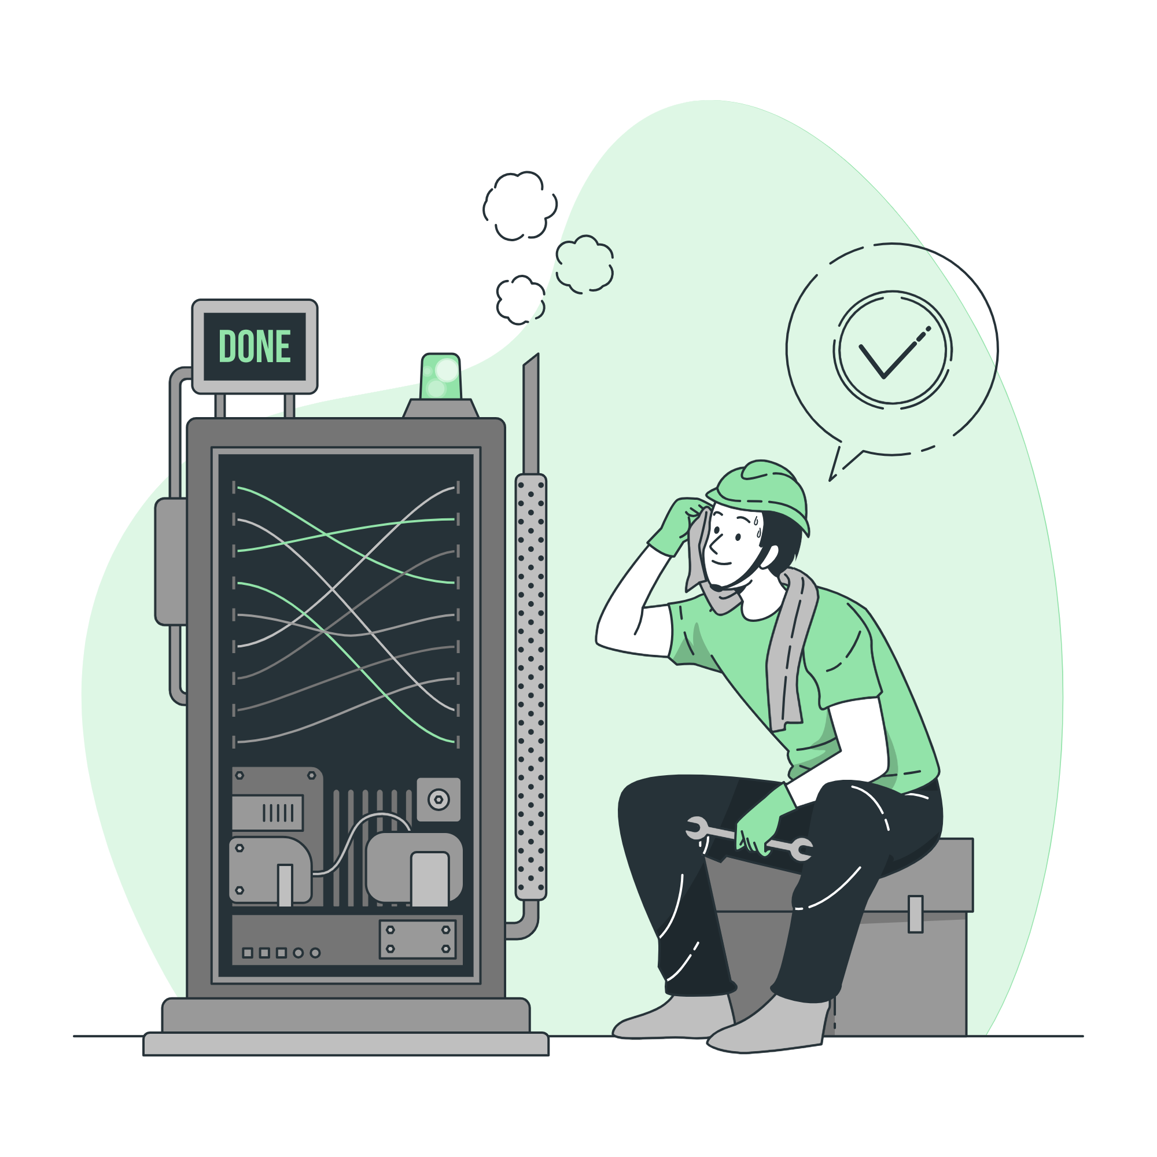
Conclusion
Friday 23 August 24
All Illustrations from Storyset.com
CODATA-RDA Data Schools

Slide 27
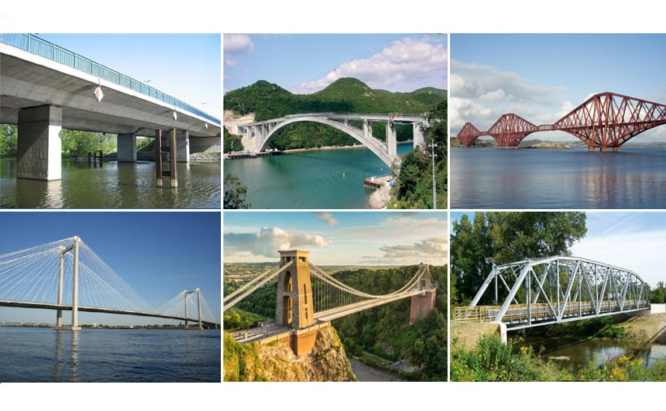
Notes:
To use the bridge metaphor, different engineering needs and styles depending on the bridge needed. Data across scientific domains has different engineering needs and requirements. Data Scientists are doing just that and to achieve responsible AI, Open Science, FAIR data we need Data professionals and you , many of you.

Slide 28
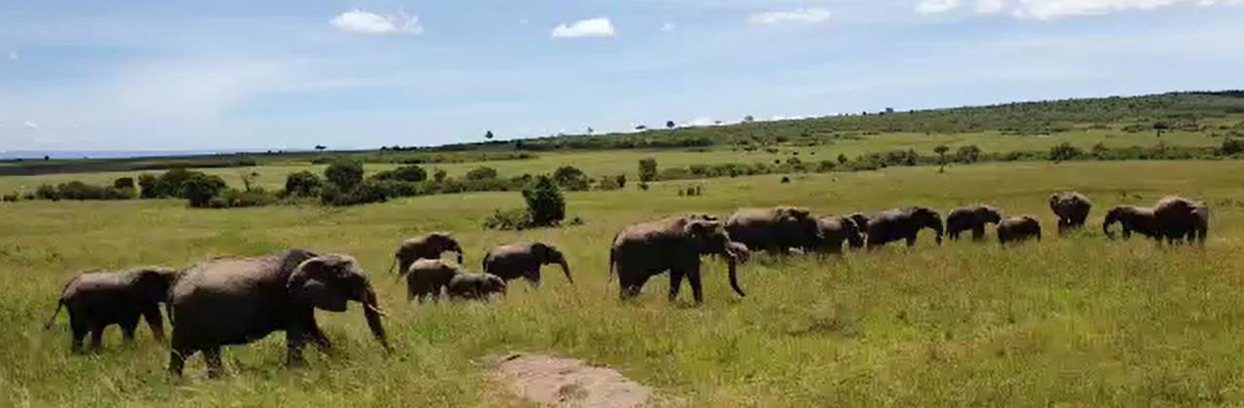
If you want to go fast, go ALONE
If you want to go far, go TOGETHER
African Proverb
Source: Lucia Messerini 2023
Notes:
So from the RDA perspective by BUILDING GLOBAL BRIDGES you can ENABLE LOCAL SUCCESS IN OPEN SCIENCE, RESEARCH DATA MANAGEMENT AND FAIR DATA
RDA has taken this African proverb as it’s mantra “If you want to go fast, go ALONE . If you want to go far, go TOGETHER"

Slide 29

Thank you
Friday 23 August 24
Hilary Hanahoe
Secretary General | Research Data Alliance
hilary.hanahoe@rda-foundation.org
All Illustrations from Storyset.com
CODATA-RDA Data Schools

